Slide 1
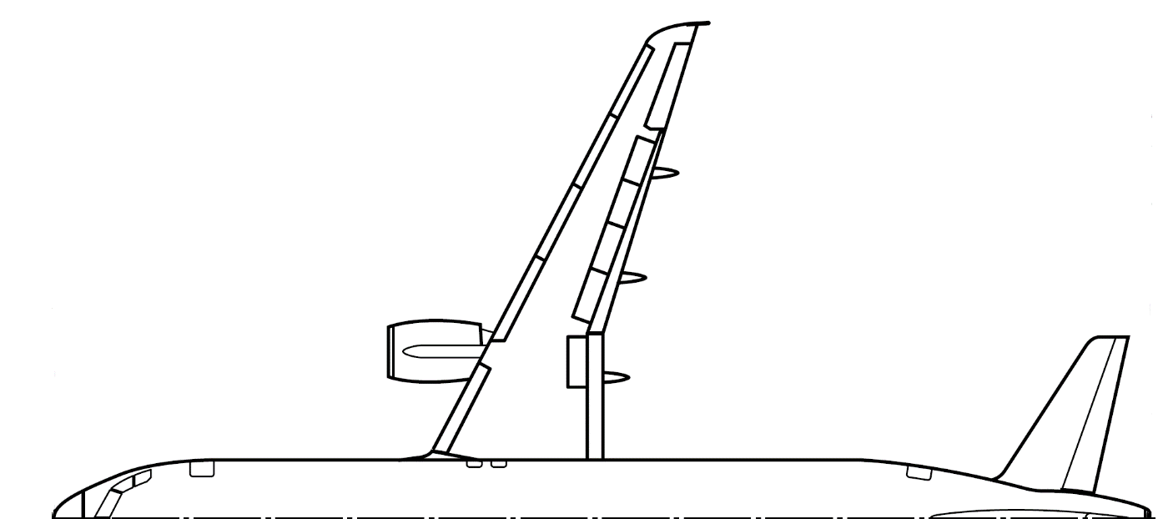
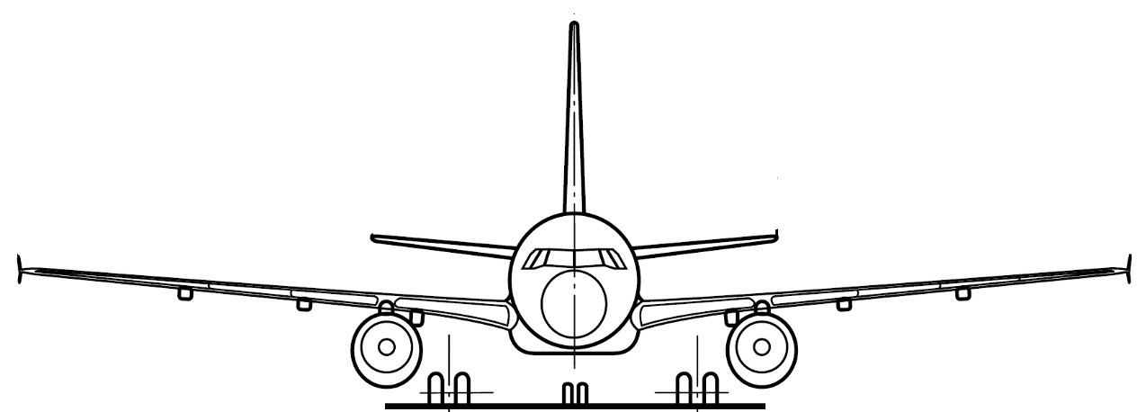
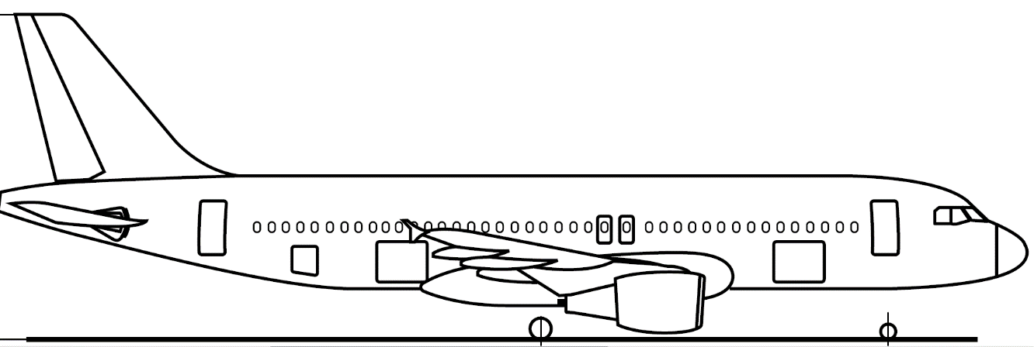
Aircraft Design Exam Preparation

Slide 2
Exam Information
February 14th 2023 11:30-13:00 in 101, Hörsaal 1, "Interims I" (5620.01.101), MW 1801, Ernst-Schmidt-Hörsaal (5508.02.801), 003, Hörsaal 2, "Interims II" (5416.01.003) (room allocation will be published soon)
Style: - Written exam
- Mixture of questions (of style multiple-choice & „free-text“) and calculation tasks (~ 50/50)
Aids: - Except from a pen, ruler and calculator (not programmable) no other aids are allowed!
- A dictionary may be used.

Slide 3
Exam Information
Other hints:
- List with equations to be known by heart is available on Moodle
Unit conversion factors will be given
You can answer in English or in German
Give numeric values with four significant digits (123400, 0.01234).
➔ for wrong roundings -0.5P will be given
➔ for missing units -0.5P will be given
In most of the calculation tasks “back-up” values will be given (there are no minus points if you use the back-up value) Also, points for subsequent errors (dt.: Folgefehler) will also be given

Slide 4
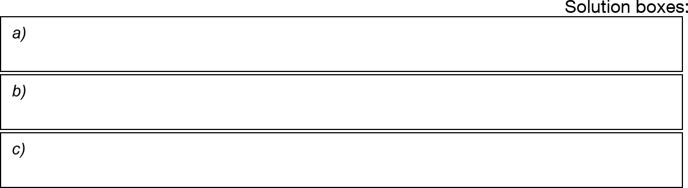
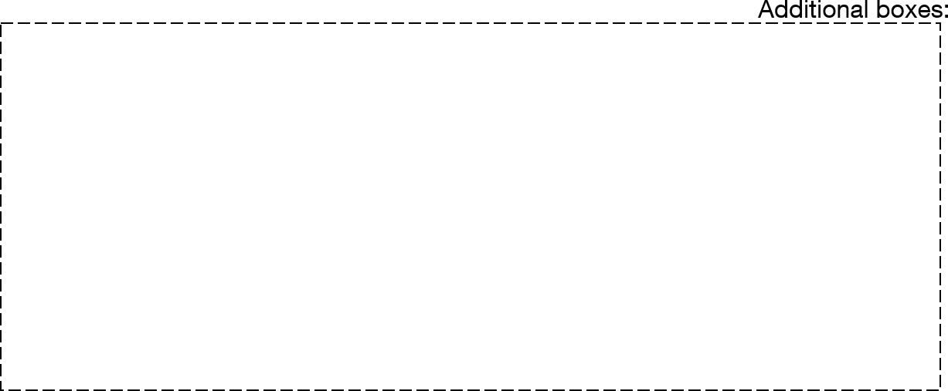
Exam Information
Calculation tasks: Always provide a comprehensive derivation of the solution. Also, if not asked otherwise, put the final solution in solution box beneath the task!
𝐴𝑅 = 9.901 ✔ correct answer + derivation, full points
Example
𝜆 = 0.2549 ✖
incorrect answer (due to typo in calculator), but in additional box equation given – points on equation
correct answer, but no derivation in additional box
equation – no points
Λ_{25%} = 22.12° ✖
_{𝑏}2
2
₌ 44.5 ✔
Here, a comprehensive derivation of the solution is required (e.g. equations etc.)
a) 𝐴𝑅 =
^{𝑆}𝑟𝑒𝑓
200
b) 𝜆 =
𝑐
𝑡𝑖𝑝
=
1.5
6.1
✔
^{𝑐}𝑟𝑜𝑜𝑡
Also uploaded in Moodle in “Exam Information”
c) ❓ ✖

Slide 5
Exam Preparation Tasks

Slide 6
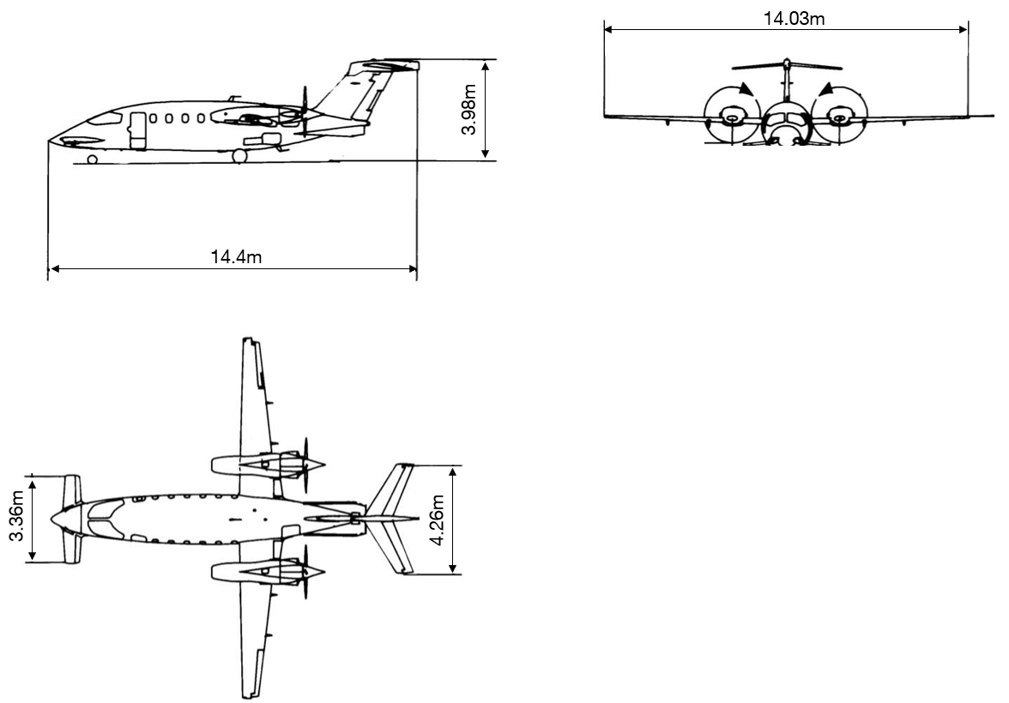
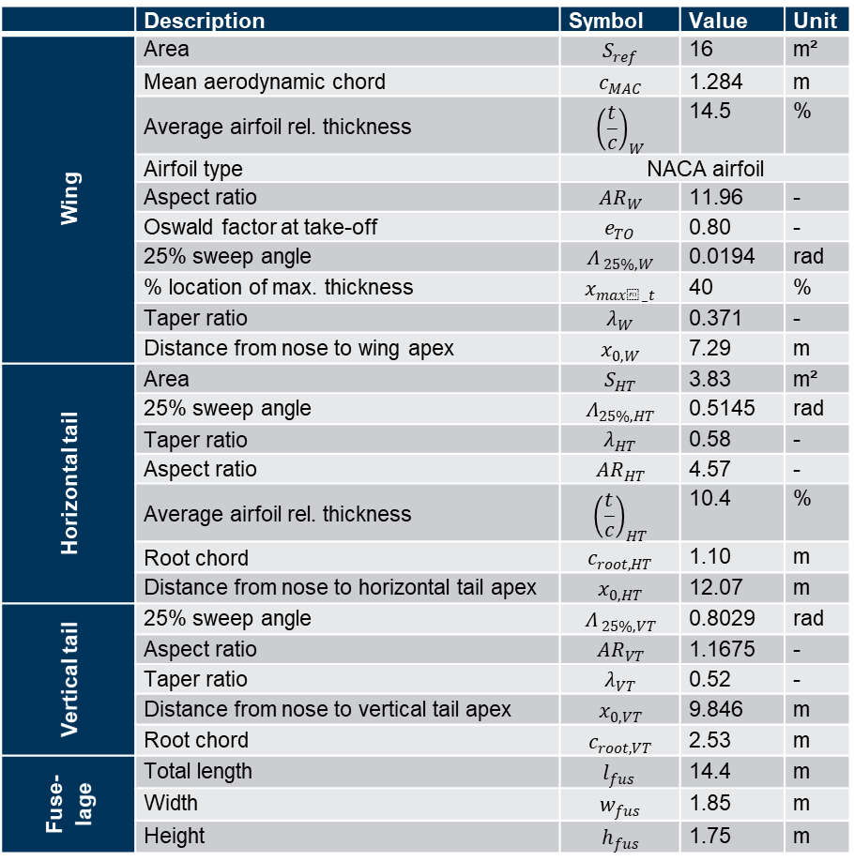
Piaggio P180
 | Description | Symbol | Value | Unit
Wing | Area | $$S_{ref}$$ | 16 | m²
 | Mean aerodynamic chord | $$c_{MAC}$$ | 1.284 | m
 | Average airfoil rel. thickness | $${\left(\frac{t}{c}\right)}_{W}$$ | 14.5 | %
 | Airfoil type | NACA airfoil
 | Aspect ratio | $${AR}_{W}$$ | 11.96 | -
 | Oswald factor at take-off | $$e_{TO}$$ | 0.80 | -
 | 25% sweep angle | $$Λ_{ 25\%,W}$$ | 0.0194 | rad
 | % location of max. thickness | $$x_{max⁡_t}$$ | 40 | %
 | Taper ratio | $$λ_{W}$$ | 0.371 | -
 | Distance from nose to wing apex | $$x_{0,W}$$ | 7.29 | m
Horizontal tail | Area | $$S_{HT}$$ | 3.83 | m²
 | 25% sweep angle | $$Λ_{25\%,HT}$$ | 0.5145 | rad
 | Taper ratio | $$λ_{HT}$$ | 0.58 | -
 | Aspect ratio | $${AR}_{HT}$$ | 4.57 | -
 | Average airfoil rel. thickness | $${\left(\frac{t}{c}\right)}_{HT}$$ | 10.4 | %
 | Root chord | $$c_{root,HT}$$ | 1.10 | m
 | Distance from nose to horizontal tail apex | $$x_{0,HT}$$ | 12.07 | m
Vertical tail | 25% sweep angle | $$Λ_{ 25\%,VT}$$ | 0.8029 | rad
 | Aspect ratio | $$AR_{VT}$$ | 1.1675 | -
 | Taper ratio | $$λ_{VT}$$ | 0.52 | -
 | Distance from nose to vertical tail apex | $$x_{0,VT}$$ | 9.846 | m
 | Root chord | $$c_{root,VT}$$ | 2.53 | m
Fuse-lage | Total length | $$l_{fus}$$ | 14.4 | m
 | Width | $$w_{fus}$$ | 1.85 | m
 | Height | $$h_{fus}$$ | 1.75 | m
 | Description | Symbol | Value | Unit
 | Take-off mass | $$m_{TO}$$ | 5239 | kg
Pressurized cabin

Slide 7
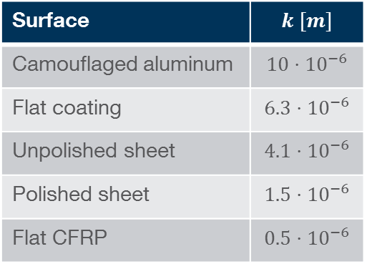
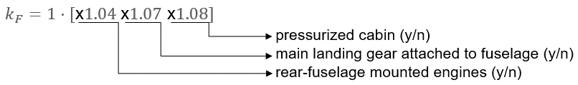


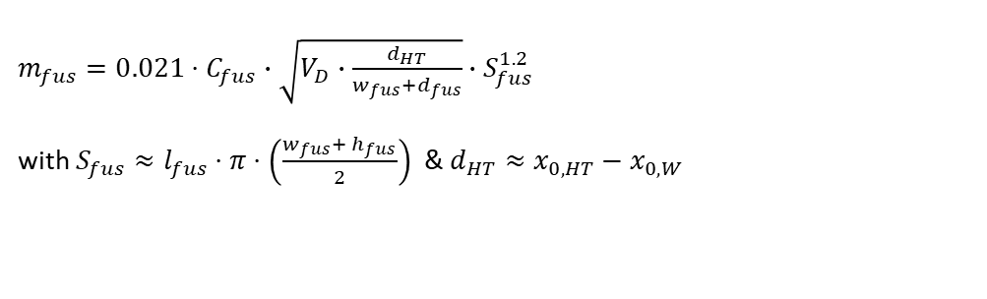

Further information
$$K=1+0.75⋅\left(\frac{t}{c}\right)$$
$$\tan\left(Λ_{m\%}\right)=\tan\left(Λ_{n\%}\right)−\frac{4}{AR}⋅\left[\frac{m−n}{100}⋅\frac{1−λ}{1+λ}\right]$$
$$F_{W}=\left[1+\frac{0.6}{{\left(x/c\right)}_{m}}∙{\left(\frac{t}{c}\right)}_{W}+100∙{\left(\frac{t}{c}\right)}_{W}^{4}\right]∙\left[1.34 ∙ M^{0.18} {cos⁡(Λ_{m})}^{0.28}\right]$$
${Re}_{CO,W}=38∙{\left(\frac{l_{ref}}{k}\right)}^{1.053}$(subsonic); ${Re}_{CO}=44∙{\left(\frac{l_{ref}}{k}\right)}^{1.053}∙M_{∞}^{1.16}$ (trans-/supersonic)
$$c_{f,lam}=\frac{1.328}{\sqrt{Re}}$$
$$c_{f,turb}=\frac{0.455}{{{(log}_{10}{Re})}^{2.58}}⋅{\left(1+0.144⋅{M_{∞}}^{2}\right)}^{−0.65}$$
$$S_{wet,W}=2⋅S_{ref}$$
$$l_{nac}=0.49∙{\left(\frac{T_{unit}}{1000}\right)}^{0.4}∙M^{0.2}$$
$$Δc_{l,max⁡(TE)}=F_{1}⋅F_{2}⋅F_{3}⋅Δc_{l,max,base}$$
$$ΔC_{L,max(TE)}=Δc_{l,max(TE)}⋅\frac{S_{W,TE}}{S_{ref}}⋅C_{Λ}$$
$$s_{acc}=\frac{1}{2}∙\overline{a}∙t^{2}=\frac{V_{TO}^{2}}{2∙\overline{a}}$$
$$\frac{\overline{w}}{g}∙\overline{a}=\overline{T}−\overline{D}$$
$$\overline{D}={\overline{D}}_{f}+{\overline{D}}_{aer}$$
$${\overline{D}}_{f}=μ_{f}∙(w_{TO}−{\overline{L}}_{TO})$$
$$D_{aer}=D_{0|clean}+{ΔD}_{flap}+{ΔD}_{LG}+D_{i}$$
$${\overline{L}}_{TO}=\frac{L_{TO \left(V=0\right)}+ L_{TO \left(V=V_{TO}\right)}}{2}$$
$$\overline{q}=\frac{q_{ \left(V=0\right)}+ q_{ \left(V=V_{TO}\right)}}{2}$$
$$C_{Di}=\frac{{\left(C_{L_{TO}}−C_{L,0}\right)}^{2}}{π∙AR∙e}−\frac{{C_{L,0}}^{2}}{π∙AR∙e}$$
$$C_{L,0}≈\frac{1}{3}∙C_{L,TO}$$
$$V_{TO}=C∙V_{S}$$
$m_{fus}=0.021⋅C_{fus}∙\sqrt{V_{D}∙\frac{d_{HT}}{w_{fus}+d_{fus}}}∙S_{fus}^{1.2}$
with $S_{fus}≈l_{fus}⋅π⋅\left(\frac{w_{fus}+ h_{fus}}{2}\right)$ & $d_{HT}≈x_{0,HT}−x_{0,W}$
$$C_{fus}$$

Slide 8
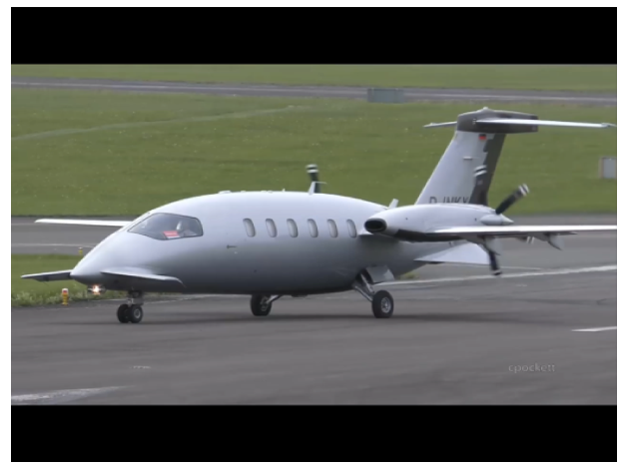
Task 1
Which configurative features are visible on the three-side view and the illustration of each aircraft? What are the corresponding derived properties for the aircraft? List at least 6 for the Piaggio P180 moderate speed (M0.6), laminar flow executive transport aircraft.
Source: https://www.youtube.com/watch?v=osKivHdFUMI

Slide 9
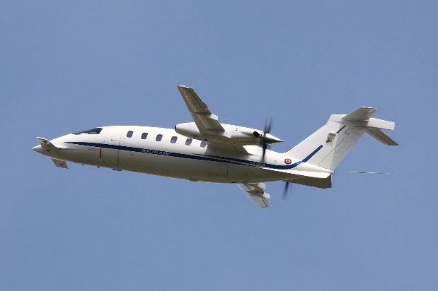
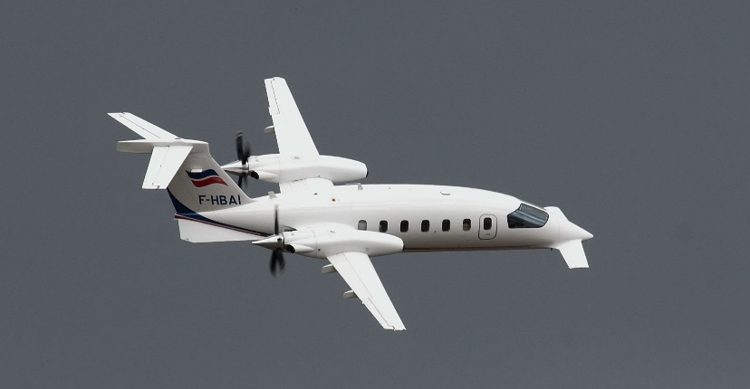
Task 1
Which configurative features are visible on the three-side view and the illustration of each aircraft? What are the corresponding derived properties for the aircraft? List at least 6 for the Piaggio P180 moderate speed (M0.6), laminar flow executive transport aircraft.
Configurative feature | Derived property

Slide 10

Task 2
Determine the lift coefficient slope of the horizontal stabilizer at $M=0.5$ on aircraft level. Due to the vertical position, the local dynamic pressure is reduced by only 5% compared to the main wings and the effective angle of attack is reduced by 10%. If more than one method is applicable, use the most precise one.

Slide 11
Task 2
Determine the lift coefficient slope of the horizontal stabilizer at $M=0.5$ on aircraft level. Due to the vertical position, the local dynamic pressure is reduced by only 5% compared to the main wings and the effective angle of attack is reduced by 10%. If more than one method is applicable, use the most precise one.

Slide 12

Task 3
Calculate the parasite drag area of the main wing during subsonic cruise flight at $h=12000m$ and $M=0.6$. Assume laminar conditions prevail on 45% of the (camouflaged aluminum) wing chord and weight the equations for the coefficient of friction accordingly.

Slide 13
Task 3
Calculate the parasite drag area of the main wing during subsonic cruise flight at $h=12000m$ and $M=0.6$. Assume laminar conditions prevail on 45% of the (camouflaged aluminum) wing chord and weight the equations for the coefficient of friction accordingly.

Slide 14
Task 3
Calculate the parasite drag area of the main wing during subsonic cruise flight at $h=12000m$ and $M=0.6$. Assume laminar conditions prevail on 45% of the (camouflaged aluminum) wing chord and weight the equations for the coefficient of friction accordingly.

Slide 15
Task 3
Calculate the parasite drag area of the main wing during subsonic cruise flight at $h=12000m$ and $M=0.6$. Assume laminar conditions prevail on 45% of the (camouflaged aluminum) wing chord and weight the equations for the coefficient of friction accordingly.

Slide 16

Break (5min)
This video is not relevant for the exam!
Exam preparation with Mr. Bean
Source: https://www.youtube.com/watch?v=-wOSrXV60MY

Slide 17
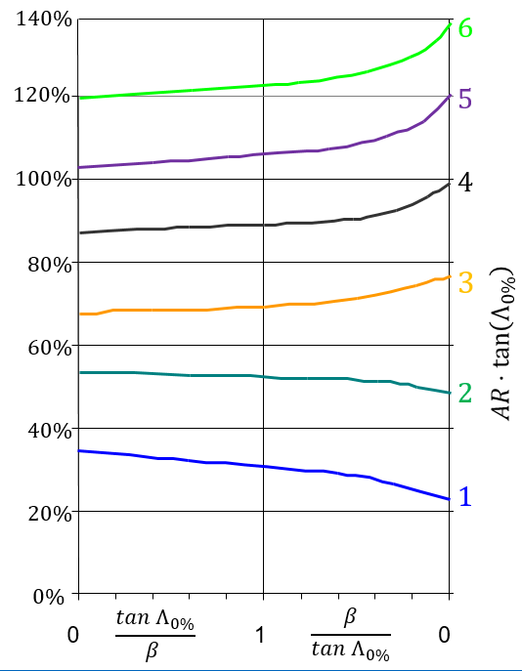



Task 4
Locate the absolute location of the aerodynamic center of the horizontal tail during approach ($M=0.3$), measured from the nose of the aircraft.
taper ratio $λ_{W}=0.5$
$$n_{AC}=\frac{x_{ac}}{c_{r}}$$

Slide 18
Task 4
Locate the absolute location of the aerodynamic center of the horizontal tail during approach ($M=0.3$), measured from the nose of the aircraft.

Slide 19

Task 5
Estimate the mass of the fuselage in kilograms. The design dive speed is $400 kn.$

Slide 20

Task 6
An upgraded version of the aircraft shall use two turbofan engines in order to reach a nominal thrust to weight ratio of ${T_{0}}/{w_{TO}}=0.4$. With the help of the sizing equations, estimate the length of the new nacelles. Cruise Mach number $M=0.6$. Assume that the BPR is lower than 6.

Slide 21
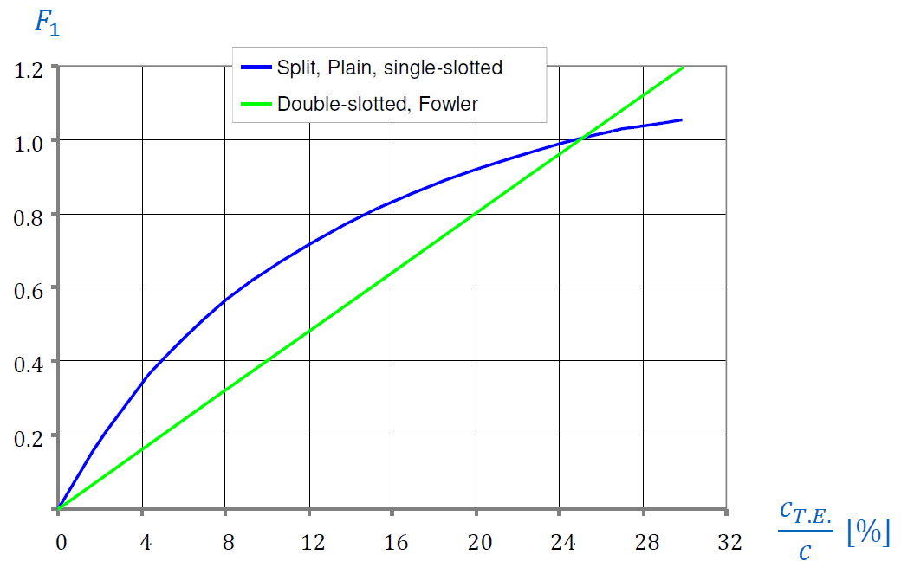


Task 7
Estimate the maximum lift coefficient increment when the (average) double-slotted trailing edge flaps are deflected by $δ_{TE}=20°$. Assume that 80% of the wing area is influenced by the flaps, which have a chord of $c_{TE}=0.2 m$.
$$\frac{c_{TE}}{c} [\%]$$

Slide 22
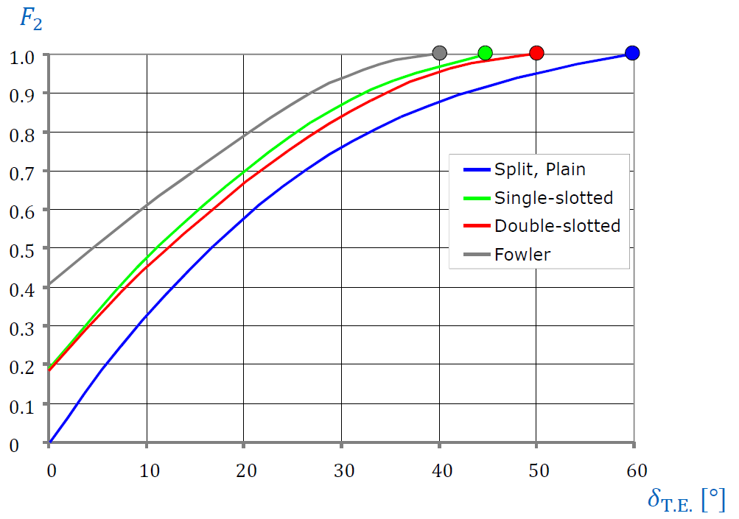
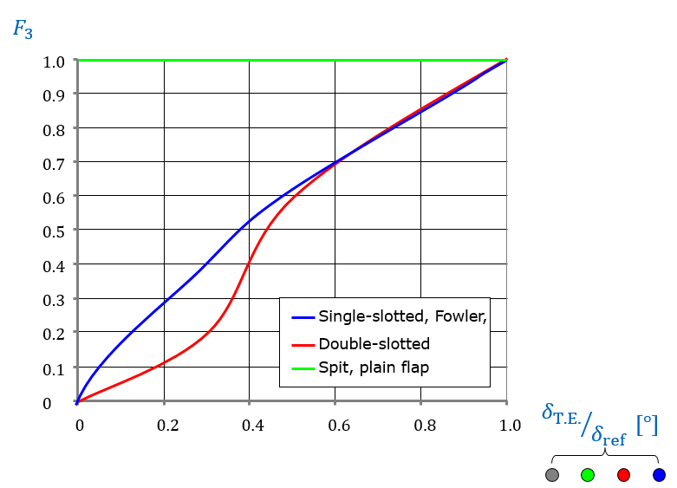

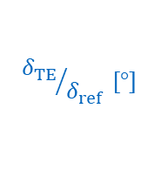
Task 7
Estimate the maximum lift coefficient increment when the (average) double-slotted trailing edge flaps are deflected by $δ_{TE}=20°$. Assume that 80% of the wing area is influenced by the flaps, which have a chord of $c_{TE}=0.2 m$.
$${δ_{TE}}/{δ_{ref}} [°]$$
$$δ_{TE} [°]$$

Slide 23
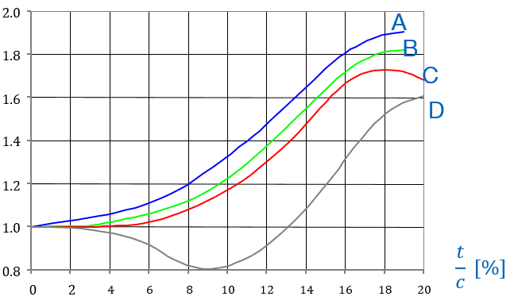

Task 7
Estimate the maximum lift coefficient increment when the (average) double-slotted trailing edge flaps are deflected by $δ_{TE}=20°$. Assume that 80% of the wing area is influenced by the flaps, which have a chord of $c_{TE}=0.2 m$.
$$Δc_{l,max,base}$$
 | Flap type | Airfoil type
A | Optimum double-slotted | NACA
B | Average double-slotted | NACA
 | Fowler | any
C | Double slotted | NACA 6 series
 | Single slotted | any
D | Split / plain | any

Slide 24
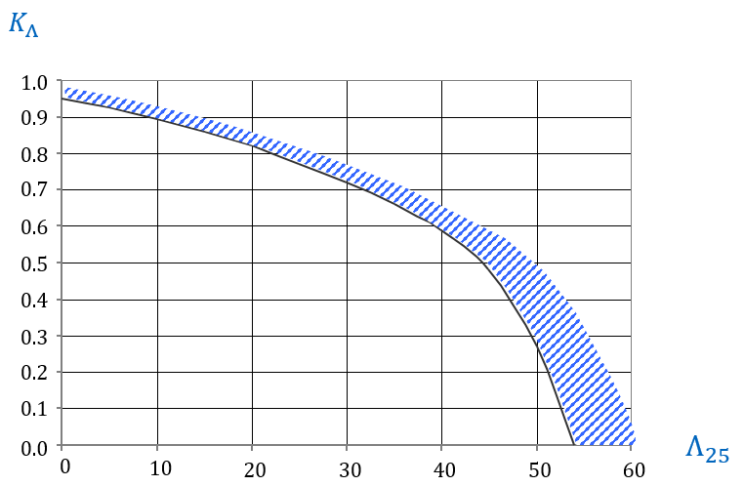

Task 7
Estimate the maximum lift coefficient increment when the (average) double-slotted trailing edge flaps are deflected by $δ_{TE}=20°$. Assume that 80% of the wing area is influenced by the flaps, which have a chord of $c_{TE}=0.2 m$.
$$C_{Λ}$$
%

Slide 25

Task 8
Draw the limit curve for a take-off distance of $s_{acc}=650 m$ at an altitude of $2000 m$ above mean sea level into a design chart (limit the number of supporting points of the resulting curve to three) and indicate the location of the design region. $C_{L,max}=2.2, C_{D0|tot}=0.016, C=1.15, C_{L,TO}=1.66, μ_{f}=0.02$.

Slide 26

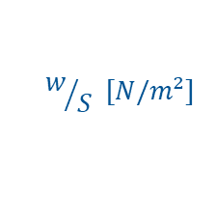
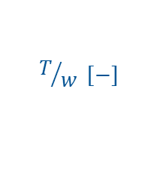
Task 8
Draw the limit curve for a take-off distance of $s_{acc}=650 m$ at an altitude of $2000 m$ above mean sea level into a design chart (limit the number of supporting points of the resulting curve to three) and indicate the location of the design region. $C_{L,max}=2.2, C_{D0|tot}=0.016, C=1.15, C_{L,TO}=1.66, μ_{f}=0.02$.
Draw curve:
$$T/w [−]$$
0.8
0.6
0.4
0.2
0
$$w/S [N/m²]$$
0 2000 4000 6000 8000

Slide 27

QUESTIONS?
Additional Resource for Exam Preparation
Question chapter with calculation tasks & theory questions at the end of the book: Raymer (2012): Aircraft Design: A Conceptual Approach, 5. ed., AIAA Education Series, Reston, Virginia.
Good luck in the exam!

